Slide 1


Big Data & Hadoop r.

Slide 2
Course Topics
Module 1
Module 6
Understanding Big Data
Hadoop Architecture
Analytics using Hive
Understanding HIVE QL
Module 2
Module 7
Hadoop Cluster Configuration
Data loading Techniques
Hadoop Project Environment
Advance Hive
NoSQL Databases and HBASE
Module 3
Module 8
Hadoop MapReduce framework
Programming in Map Reduce
Advance HBASE
Zookeeper Service
Module 4
Module 9
Advance MapReduce
MRUnit testing framework
Hadoop 2.0 – New Features
Programming in MRv2
Module 5
Analytics using Pig
Understanding Pig Latin
Module 10
Apache Oozie
Real world Datasets and Analysis
Project Discussion

Slide 3
Topics for Today
What is Hive?
Where to use Hive
Why go for Hive when PIG is there?
Let’s start - Hive Architecture
Hive Components
Hive Background
How Facebook uses Hive
Limitation of Hive
Abilities of Hive Query Language
Differences with Traditional RDBMS
Hive Types
Examples

Slide 4
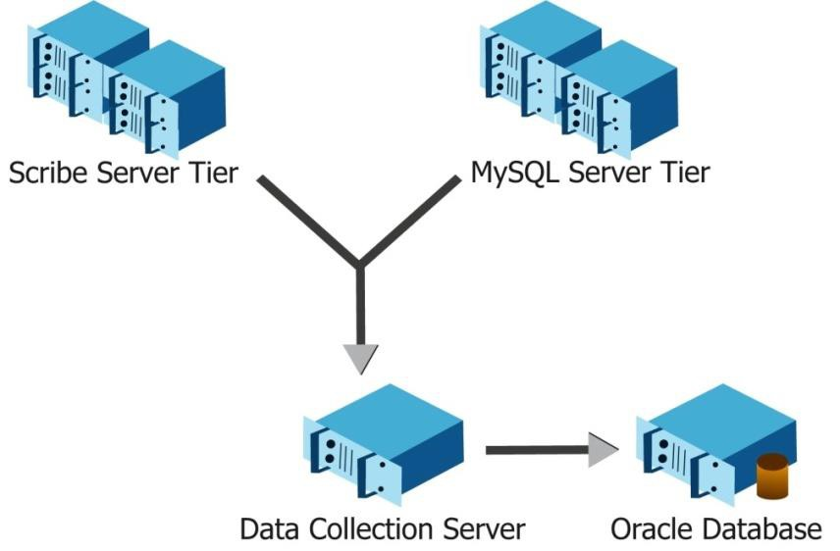
Hive Background
Started at Facebook.
Data was collected by nightly cron jobs into Oracle DB.
“ETL” via hand-coded python.
Grew from 10s of GBs (2006) to 1 TB/day new data (2007), now 10x that.

Slide 5








Hive Use Case @ Facebook
Challenge…
> 950
Million Users
> 500
Terabytes
per day
> 70k
queries per day
> 300
million photos per day

Slide 6
Hive Use Case @ Facebook
Challenge…
> 950
Million Users
> 500
Terabytes
per day
> 70k
queries per day
> 300
million photos per day
Traditional RDBMS…_{X}

Slide 7



Hive Use Case @ Facebook
Challenge…
> 950
Million Users
> 500
Terabytes
per day
> 70k
queries per day
> 300
million photos per day
Traditional RDBMS…_{X}
Solution…

Slide 8



Hive Use Case @ Facebook
Challenge…
> 950
Million Users
> 500
Terabytes
per day
> 70k
queries per day
> 300
million photos per day
Traditional RDBMS…_{X}
Solution…
Hard to program
Users know SQL well

Slide 9














Hive Use Case @ Facebook
Challenge…
> 950
Million Users
> 500
Terabytes
per day
> 70k
queries per day
> 300
million photos per day
Traditional RDBMS…_{X}
Solution…
Hard to program
Users know SQL well
Tables can be partitioned and bucketed
Schema flexibility and evolution
Easy to plug-in custom mapper/ reducer code
JDBC/ODBC
drivers are available
HIVE tables can be defined directly on HDFS
Extensible: Types, Formats, Functions, Scripts

Slide 10


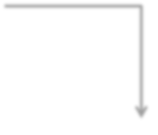
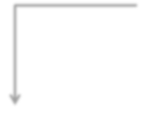



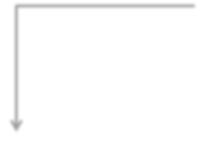




Use Case In Healthcare
Load CSV file into Hive
Hive stores the data internally on HDFS
HDFS
Read data
from Hive
table
Deidentify columns and store the data back in a Hive table
Hive Script

Slide 11
What Is Hive?
Data Warehousing package built on top of Hadoop
Used for data analysis
Targeted towards users comfortable with SQL
It is similar to SQL and called HiveQL
For managing and querying structured data
Abstracts complexity of Hadoop
No need learn java and Hadoop APIs
Developed by Facebook and contributed to community
Facebook analyzed several Terabytes of data everyday using Hive

Slide 12




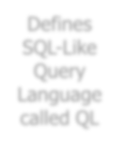









What Is Hive?
Defines SQL-Like Query Language called QL
Data Warehouse Infrastructure
Allows programmers to plug-in custom mappers and reducers
Provides tools to enable easy data ETL

Slide 13



















Where To Use Hive?
Data
Mining
Log
Processing
HIVE
Applications
Document
Indexing
Customer-facing
Business Intelligence
Predictive Modeling,
Hypothesis Testing

Slide 14


Why Go For Hive When Pig Is There?
PigLatin:
HiveQL:
Procedural data-flow language A = load ‘mydata’;
Dump A;
Declarative SQLish language Select * from ‘mytable’;
Pig is used by Programmers and
Researchers
Hive is used by Analysts generating daily reports

Slide 15
Why Go For Hive When Pig Is There?
Features | Hive | Pig
Language | SQL-like | PigLatin
Schemas/Types | Yes (explicit) | Yes (implicit)
Partitions | Yes | No
Server | Optional (Thrift) | No
User Defined Functions (UDF) | Yes (Java) | Yes (Java)
Custom Serializer/Deserializer | Yes | Yes
DFS Direct Access | Yes (implicit) | Yes (explicit)
Join/Order/Sort | Yes | Yes
Shell | Yes | Yes
Streaming | Yes | Yes
Web Interface | Yes | No
JDBC/ODBC | Yes (limited) | No

Slide 16







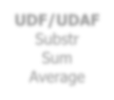





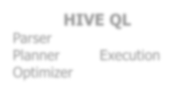








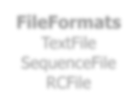
Hive Architecture
Map Reduce
HDFS
JDBC/ODBC
Browse, Query, DDL
User-Defined
MapReduce Scripts
UDF/UDAF
Substr Sum Average
HIVE QL
Parser
Metastore
Thrift API
Planner
Execution
Optimizer
SerDe
CSV
Thrift
Regex
FileFormats TextFile SequenceFile RCFile

Slide 17





Hive Components
Shell
HIVE
Components
Driver
Metastore
Compiler
Execution
Engine

Slide 18
























Metastore
HIVE Service JVM
Embedded Metastore
Driver
Metastore
Derby
Local Metastore
Driver
Metastore
MySQL
Driver
Metastore
Driver
Metastore Server JVM
Remote
Metastore
MySQL
Driver
Metastore Server JVM

Slide 19
Limitations of HIVE?
Not designed for online transaction processing
Does not offer real-time queries and row level updates
Latency for Hive queries is generally very high (minutes)
Provides acceptable (not optimal) latency for interactive data browsing

Slide 20











Abilities of HIVE Query Language
Hive Query Language provides the basic SQL-like operations
Ability to filter rows from a table using a ‘where’ clause
Ability to store the results of a query into another table
HIVE
Query Language
Ability to do equi- joins between two tables
Ability to manage tables and partitions (create, drop & alter)
Ability to store the results of a query in Hadoop dfs directory

Slide 21
Differences With Traditional RDBMS
Schema on Read vs Schema on Write
Hive does not verifies the data when it is loaded, but rather when a query is issued.
Schema on read makes for a very fast initial load, since the data does not have to be read, parsed and serialized to disk in the database’s internal format. The load operation is just a file copy or move.
No Updates, Transactions and Indexes.

Slide 22











Type System
Boolean Type
BOOLEAN – TRUE/FALSE
Integers
TINYINT – 1 byte integer SMALLINT – 2 byte integer INT – 4 byte integer BIGINT – 8 byte integer
Primitive Types
Floating Point Numbers FLOAT – Single Precision DOUBLE – Double Precision
String Type
STRING –
Sequence of characters

Slide 23




Complex Types
Complex Types can be built up from primitive types and other composite types using the following three operators:
Structs:
It can be accessed using the DOT (.) notation.
Maps:
(key-value tuples) It can be accessed using [‘element name’] notation.
Arrays: (indexable lists) Elements can be accessed using the [n] notation where
n is an index (zero- based) into the array.

Slide 24














Hive Data Models
Databases
Namespaces
HIVE Data (In the order of granularity)
Tables
Schemas in namespaces
Databases
Tables
Partitions
timestamp
How data is stored in HDFS
Grouping data bases on some column
Can have one or more columns
Userid
referer_url
Buckets or Clusters
Partitions divided further into buckets
bases on some other column
Use for data sampling
page_url
IP

Slide 25







Partitions
Partition means dividing a table into a coarse grained parts based on the value of a partition column such as a date. This make it faster to do queries on slices of the data.
Partitions
Each unique value of the partition keys defines a partition of the table
Partition keys determine how the data is stored
Partitions are named after dates for convenience

Slide 26
Create Database And Table
Create Database
Create database retail;
Use Database
Use retail;
Create table for storing transactional records
Create table txnrecords(txnno INT, txndate STRING, custno INT, amount DOUBLE, category STRING, product STRING, city STRING, state String, Spendby String )
Row format delimited
Fields terminated by ‘,’ stored as textfile

Slide 27




External Tables
Create the table in another hdfs location and not in warehouse directory
Not managed by hive
CREATE EXTERNAL TABLE external_Table (dummy STRING)
LOCATION ‘/user/notroot/external_table’;
Need to specify the hdfs location
Hive does not delete the table (or hdfs files) even when the tables are dropped.
It leaves the table untouched and only metadata about the tables are deleted.

Slide 28
Load Data
Load the data into the table
LOAD DATA LOCAL INPATH ’/home/ubuntu/notroot/data/txn.csv’
OVERWRITE INTO TABLE txnrecords;
Describing metadata or schema of the table
Describe txnrecords;

Slide 29
Queries
Select
Select count(*) from txnrecords;
Aggregation
Select count (DISTINCT category) from txnrecords;
Grouping
Select category, sum( amount ) from txnrecords group by category

Slide 30
Managing Outputs
Inserting Output into another table
INSERT OVERWRITE TABLE results ( SELECT * from txnrecords)
Inserting into local file
INSERT OVERWRITE LOCAL DIRECTORY’tmp/results’ (SELECT * from txnrecords)

Slide 31
Revisiting Use Case in Healthcare
Load CSV file into Hive
Hive stores the data internally on HDFS
HDFS
Read data
from Hive
table
Deidentify columns and store the data back in a Hive table
Hive Script

Slide 32
Joining Two tables
User Table
Id | Email | Language | Location
1 | edureka@1. com | EN | US
2 | edureka@2. com | EN | GB
3 | edureka@3. com | FR | FR
Transaction Table
Id | Product Id | UserId | Purchase Amount | Item Description
1 | Prod-1 | 1 | 300 | A jumper
2 | Prod-1 | 2 | 300 | A jumper
3 | Prod-1 | 2 | 300 | A jumper
4 | Prod-2 | 3 | 100 | A rubber chicken
5 | Prod-1 | 3 | 300 | A jumper

Slide 33

Joining Two tables
User Table
Id | Email | Language | Location
1 | edureka@1. com | EN | US
2 | edureka@2. com | EN | GB
3 | edureka@3. com | FR | FR
Prod 1
Transaction Table
Id | Product Id | UserId | Purchase Amount | Item Description
1 | Prod-1 | 1 | 300 | A jumper
2 | Prod-1 | 2 | 300 | A jumper
3 | Prod-1 | 2 | 300 | A jumper
4 | Prod-2 | 3 | 100 | A rubber chicken
5 | Prod-1 | 3 | 300 | A jumper

Slide 34
Joining Two tables
User Table
Id | Email | Language | Location
1 | edureka@1. com | EN | US
2 | edureka@2. com | EN | GB
3 | edureka@3. com | FR | FR
Prod 2
Transaction Table
Id | Product Id | UserId | Purchase Amount | Item Description
1 | Prod-1 | 1 | 300 | A jumper
2 | Prod-1 | 2 | 300 | A jumper
3 | Prod-1 | 2 | 300 | A jumper
4 | Prod-2 | 3 | 100 | A rubber chicken
5 | Prod-1 | 3 | 300 | A jumper

Slide 35



Joining Two tables
User Table
Id | Email | Language | Location
1 | edureka@1. com | EN | US
2 | edureka@2. com | EN | GB
3 | edureka@3. com | FR | FR
Product Location
Prod-1 3 Prod-2 1
Transaction Table
Id | Product Id | UserId | Purchase Amount | Item Description
1 | Prod-1 | 1 | 300 | A jumper
2 | Prod-1 | 2 | 300 | A jumper
3 | Prod-1 | 2 | 300 | A jumper
4 | Prod-2 | 3 | 100 | A rubber chicken
5 | Prod-1 | 3 | 300 | A jumper

Slide 36
Assignment For Hive
Attempt the following assignment using the document present in the LMS under the
tab Week 5:
Running Hive on Cloudera
Execute Hive Queries on Txns Dataset
Execute Health Care Use-Case
Attempt Assignment Week 5

Slide 37

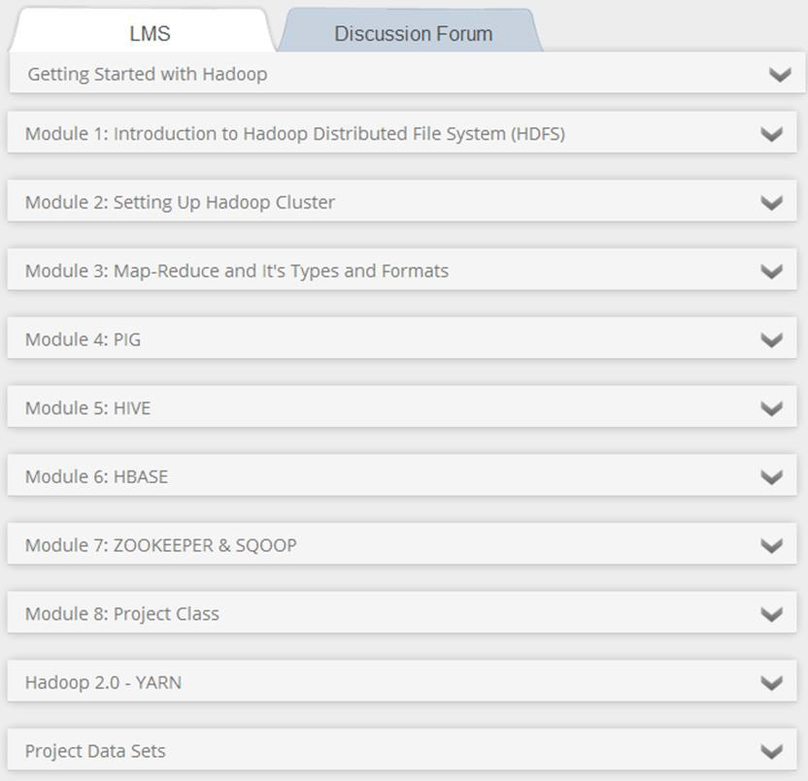
What’s within the LMS
Click here to expand and view all the elements of this Module

Slide 38

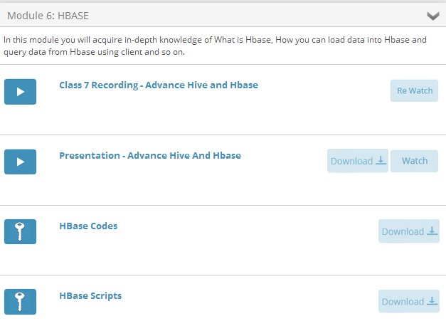
What’s within the LMS
Recording of the Class
Presentation
Codes Snippet
Scripts

Slide 39

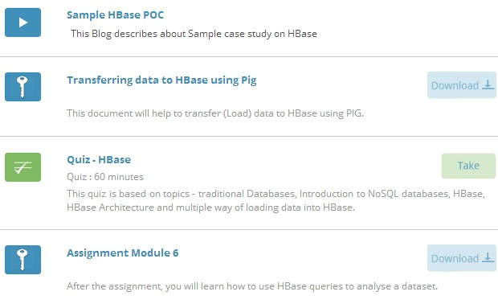
What’s within the LMS
Hands-on Guides
Quiz
Assignment

